Slide 1
Contextualizing Space Transition Theory: A Socio Technical Exploratory Study of Cybercrimes in Khyber Pakhtunkhwa
3rd International Conference on Computational Intelligent Systems 2024
(ICCIS2024)
Authors: Rizwan Ullah
Tariq Zaman
ASSETT, University of Technology Sarawak, Malaysia

Slide 2
Contents
I : Introduction
Information System and Cyber Resilience
Organizational Structure of Cybercrime Wing
The Context, Problem Statement
Research Questions, Research Objectives
II: Background
Information System and Cyber Resilience
Space Transition Theory & Motivations:
The Context
Digital tools to deal with the Cybercrimes in Pakistan
III. Methadology
Grounded Theory
IV: Findings / Results
Overall Cybercrime 2020 – 2022
Medium / Platform used in cybercrimes
Tools / Devices used in Cybercrimes
Motivation / Motives behind cases
V: Discussion

Slide 3
I- Introduction
ICT is a double edge sword (Jiao, Bungay and Jenkins, 2021).
ICT provides us access to better information, which helps in making better & timely decisions to social, economic and moral outcomes.
ICT can spur human hostile behaviours (Mowengla, 2015).
Toyoma (2011) presented a theory of technology as an amplifier.
Technology is like a tool … amplifies the intentions and abilities
It can be Positive and Negative
e.g. Facebook –
Connects us on clicks with people …. supporting a social cause (Zollo and Quattrociocchi, 2018).
Played a role in facilitating cybercrimes - identity theft, scams and misinformation (Hong, 2022).

Slide 4
Introduction – Cont …
Global financial losses from cybercrimes approaches $1-Trillion (McAfee,2020).
But why it is happening ?
Lack of knowledge & Skills
Capacity to better understand
Combat Cyber crimes (Zollo and Quattrociocchi, 2018).
Another Study in India, Malaysia, Pakistan, Philippines & Republic of Korea women are often assaulted online, due to lack of digital skills, women / girls are at greater risk. (UN Women,2020).

Slide 5
Introduction – Cont …
Our review also shows that the previous studies are based on
Small-sample,
Qualitative approaches, and
Primary data.
In this study, we propose
A study of the cybercrimes in three regions of Pakistan, based on three different processes;
Study the determinants of the reported cybercrimes - 282 cybercrime FIRs in KP Province
Localize the space transition theory within the local context and further
Co-design a digital tool for the prevention of cybercrimes.

Slide 6
II- Background

Slide 7
Information Systems and Cyber Resilience
Cyberattacks like hoaxes and spear-phishing take advantage of human weaknesses to spread and cause harm. (Yekta & Semire, 2019).
e.g. Exploiting trust, emotional manipulation, Social engineering Impersonation and Spoofing
In the past, the main focus for protecting against cybercrimes was on technology. It is now recognized that human factors play a crucial role.
To effectively protect organizations and societies,
It is important to address not only technological concerns but also
factors related to human behavior and organizational aspects.
This includes implementing security policies and providing training to users.
Focus is shifting from just cybersecurity to cyber resilience.

Slide 8
Cyber Resilience
(Tibor & Kovacs,2020) define Cyber reilience as:
Cyber resilience means being able to adapt, withstand, and recover from cyber threats by using
proactive measures,
strong security practices, and
a mindset that encourages
continuous learning,
critical thinking, and
responsible digital behavior.
It involves not only the technical aspects of safeguarding information systems but also creating a culture that promotes
cybersecurity awareness,
preparedness, and
the ability to respond to and reduce cyber risks through informed decision-making and adaptable behaviors

Slide 9
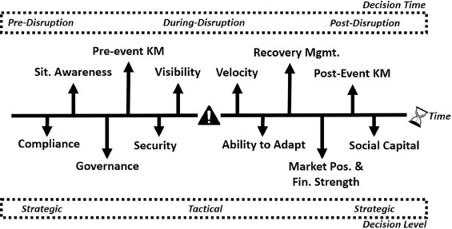
Categorization of resilience frameworks Guerra and Sepulveda Estay (2019)
Classification system that has twelve (12) categories.
Timeframework include
before …. during ….. after an intruption.
The level at which these decisonis are made is divided into two parts.
1. The Strategic Level
2. The Operational Level

Slide 10
Theoretical Framework: Space Transition Theory
For theoretical framing,
This study will use Space Transition Theory to explain “the causation of crimes in cyberspace” (Jaishankar, 2007).
The transition, in this case, refers to person’s movement from physical space to cyberspace. To explain cybercriminal activity, space transition theory postulates the following (Jaishankar, 2008);

Slide 11
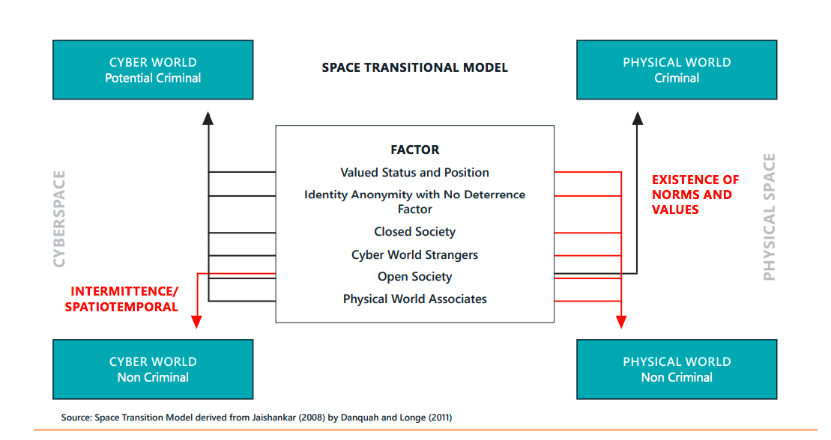
Space Transition Model

Slide 12
Space Transition Theory
Persons, with reppresssed criminal behaviour (in the physical space) may be inclined to commit crimes in cyberspace, wich, otherwise they would not commit physical space due to their social status and position.
The presence of identity flexibility, dissociative anonymity, and the lack of deterrence factors in cyberspace provide the offenders a choice to commit cybercrime.
The criminal behavior of offenders in cyberspace is likely to be imported to physical space, and similarly, activities originating in the physical space can be exported to cyberspace.
The intermittent involvement of offenders into cyberspace and the dynamic spacio-temporal nature of cyberspace provide the chance to escape.

Slide 13
Space Transition Theory – Cont …
5 a. Strangers are more likely to come together in cyberspace and collaborate to commit crimes in the physical space.
5 b. Associate of physical space are likely to unite to commit crimes in cyberspace.
Persons from closed societies, where access to information and social interaction is limited, are more prone to engaging in cybercrimes compared to individuals from open societies.
The conflict of norms and values of the physical space with the Norms and values of cyberspace may lead to cybercrimes.

Slide 14
Motivation
This component reffers to the various factors that “Push” people to carry out cybercrimes.
It is a driving force behind human action.
First they are triggered by the determinants of crimes for example unemployment, low median income, poverty, wage inequality, social status etc. (Buonanno, 2003).
Driven by the desire to fullfill or satisfy “needs” then they induldge into the act.

Slide 15
Motivation
Motivation refers to the factors that “push” individuals to commit cybercrime (Smith, 2021).
People commit crime when contributing factors cause them to become motivated to carry out criminal behavior. Without motivation, even if opportunity and vulnerabilities are present according to the Routine Activity theory a crime will not occur (Smith, 2021).
Smith, T. (2021). A Conceptual Review and Exploratory Evaluation of the Motivations for Cybercrime.

Slide 16
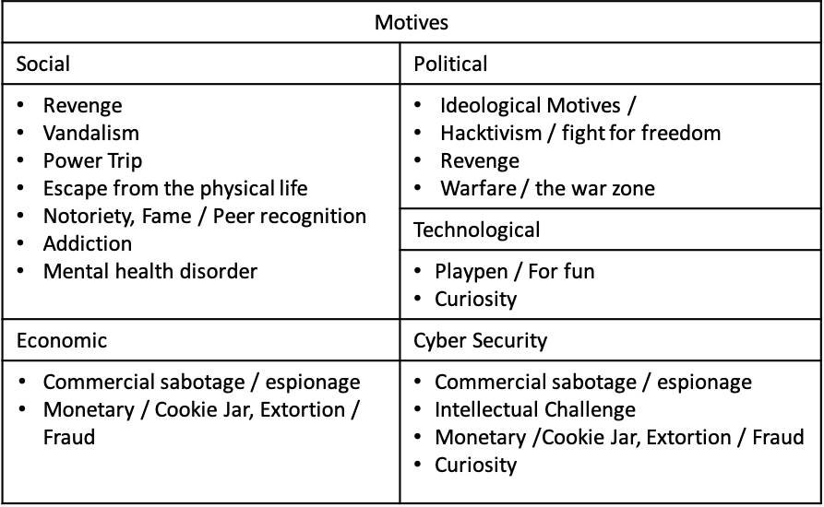


Cyber World
Potential Criminal
Physical World
Criminal
1. Persons, with repressed criminal behavior (in the physical space) have a propensity to commit crime in cyberspace, which, otherwise they would not commit in physical space, due to their status and position.
2. Identity Flexibility, Dissociative Anonymity and lack of deterrence factor in the cyberspace provides the offenders the choice to commit cyber crime.
4. Intermittent ventures of the offenders in to the cyberspace and the dynamic spatio-temporal nature of cyberspace provide the chance to escape.
6. Persons from closed society are more likely to commit crimes in cyberspace than persons from open society.
7. The conflict of Norms and Values of the physical space with the Norms and Values of cyberspace may lead to cyber crimes.
5. (a) Strangers are likely to unite together in cyberspace to commit crime in the physical space.
(b) Associates of physical space are likely to unite to commit crime in cyberspace.
Cyber World
N0n-Criminal
3. Criminal behavior of the offenders in cyberspace is likely to be imported to physical space which, in physical space may be exported to cyberspace as well.
Physical World
Non-Criminal

Slide 17
The Context
Recent years have seen a significant rise in cybercrimes in Pakistan, presenting major challenges to digital security.
The study will focus on 03 Regions contains 30 number of districts in the Khyber Pakhtunkhwa Province of Pakistan.
In 2021, the Federal Investigation Agency (FIA) recorded over 4,000 reported cybercrime cases, including fake online accounts, hate speech, hacking, online financial fraud, and illegal SIM cards.
Financial fraud is the most prevalent type of cybercrime in Pakistan, with over 20,000 reported cases in 2020 out of a total of 84,764 complaints.
In 2021, approximately 23% of reported cybercrimes were linked to activities on Facebook (Griffiths, 2023).

Slide 18
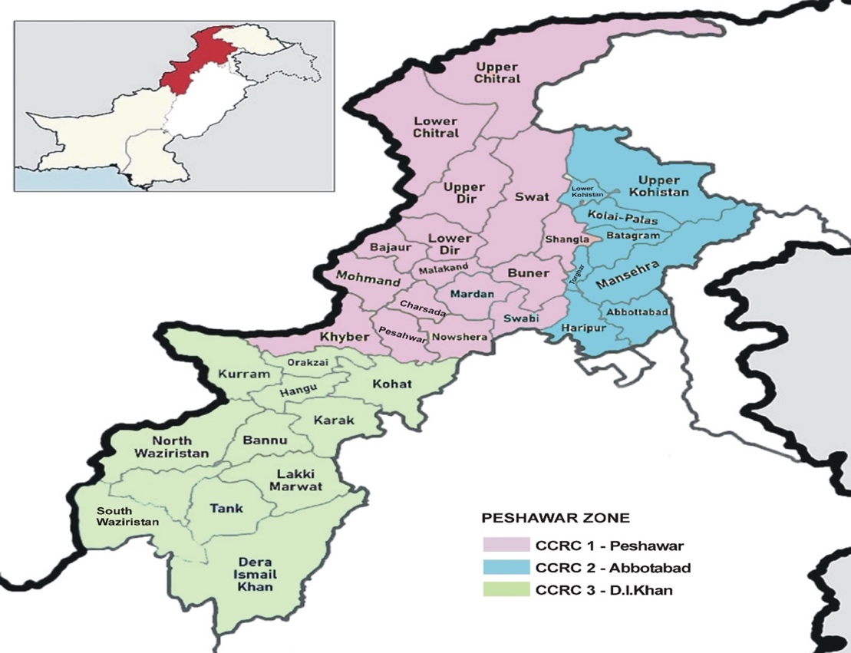
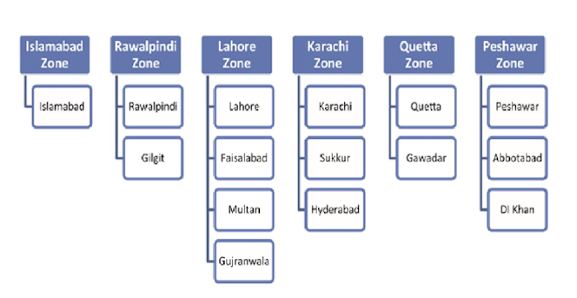
Organizational Structure of Cyber Crime Wing (CCW) Headquarter
Cybercrime Reporting Centres | No of Districts | Population (Census-2017) | Area Sq Km | Reported Cybercrime Cases
 |  |  |  | 2020 | 2021 | 2022 | Total
Peshawar | 14 | 21,524,975 | 43471 Sq Km | 40 | 68 | 47 | 155
Abbottabad | 06 | 5,323,155 | 17063 Sq Km | 23 | 30 | 31 | 84
D.I Khan | 10 | 8,653,834 | 41207 Sq Km | 07 | 11 | 25 | 43
Total | 30 | 35,501,964 | 101741 Sq Km | 70 | 109 | 74 | 282

Slide 19
Digital Tools to Deal with the Cybercrimes in Pakistan
NCCS (National Center for Cyber Security) .… devleoped number of tools to handle local challenges of cyber crimes in the country.
1. Netspection – Security assessments of computer networks and systems.
To identify vulnerabilities and weaknesses in network infrastructure.
2. SIEM – (Security Information and Event Management)
For detecting and responding to security incidents by providing real- time monitoring, threat intelligence, and log management.
3. PKIChain - Public Key Infrastructure (PKI) system
For managing and securing the issuance and revocation of digital certificates in a chain-like manner.
4. Security & Threat Intellingence Platform -
It combines threat intelligence feeds, security analytics, and other tools to enhance an organization's overall security posture.

Slide 20
5. File Integrity Monitoring (FIM) –
Monitors and detects unauthorized changes or modifications made to files and directories.
Ensuring the integrity and security of critical system files and sensitive data.
6. ThingzAnalyzer –
Identifying potential weaknesses in IoT devices and provides recommendations for improving their security.
7. ThingzFirewall Lite -
Protecting IoT devices from unauthorized access, network threats, and malicious activities by filtering incoming and outgoing network traffic.
8. Automated Tool for Security Asset Classification (ATSAC) –
Identifying and prioritizing critical assets based on their value and importance to the organization's security.
9. ISSL-Testbed for Web Application Vulnerabilities –
ISSL stands for Information Security and Services Lab.
Identifying and fixing potential vulnerabilities before they can be exploited by attackers.

Slide 21
10. Evolutionary Algorithm Based Vulnerability Detection Tool (EAB-VDT) –
Uses evolutionary algorithms to detect vulnerabilities in software or computer systems.
It employs techniques to identify potential security weaknesses.
11. Software Testbed for Cyber Secured Smart Logistics Framework –
Designed for testing and evaluating the security aspects of a smart logistics framework.
12. Smart Container –
a digitally enhanced shipping container equipped with sensors, tracking devices, and communication technologies.
It enables real-time monitoring of container location, temperature, humidity, and other factors to ensure secure and efficient transportation of goods.
13. Supply Chain Management Application –
A software tool used to manage and optimize the flow of goods, information, and resources across a supply chain.

Slide 22
14. Pseudonym-based Anonymous Chat Application (Chapp) –
Provides anonymous communication through the use of pseudonyms.
It allows users to engage in chat conversations without revealing their real identities, providing a level of privacy and anonymity.
15. Operating System Compliance Toolkit –
Assist organizations in ensuring their computer systems and networks comply with specific security and regulatory standards.
16. Web Security Assessment Toolkit –
Used for evaluating the security of web applications and websites.
17. Firmware Extraction Analysis and Security Assessment Toolkit –
Designed to extract firmware from embedded devices, such as routers or IoT devices, and analyze it for security vulnerabilities.
It helps in assessing the security of firmware and identifying potential weaknesses or backdoors.

Slide 23
III- Methadology

Slide 24
Methadology
This study applies Grounded Theory approach to explore the determinants of cybercrimes within the Peshawar Zone.
This approach is particularly effective for examining complex issues like cybercrime because it allows researchers to construct theories directly from observed data rather than testing pre-existing hypotheses.
In this study, the focus is on analyzing 282 First Information Reports (FIRs) of cybercrimes reported in the Peshawar Zone in year 2020, 2021 & 2022.
Grounded Theory involves continuously comparing data to develop more abstract concepts (Glasser, 2010).
Through constant comparative analysis, recurring themes were identified, leading to a deeper understanding of local cybercrime dynamics.

Slide 25
Methadology
The analysis followed the principles of Grounded Theory, utilizing open, axial, and selective coding to derive insights from raw data.
A. Open Coding (First Phase)
Data was examined line-by-line, identifying key phrases, incidents, and factors in each FIR.
Initial codes were created to label concepts related to cybercrime motives, methods, and patterns without any predefined categories.
The data was broken down into parts, allowing identification of recurring terms and initial concepts like attack methods, tools, platforms, and demographics of victims and accused individuals.

Slide 26
B. Axial Coding (Second Phase)
Related codes were grouped into broader categories by identifying relationships between them.
Central themes, such as motivations for cyber offenses, methods of cybercrime, and targeted demographics, were established.
This step linked initial codes to create cohesive themes, offering a structured understanding of patterns and determinants in cybercrime.
A deeper analysis of conditions, contexts, and consequences associated with each category was also conducted.
C. Selective Coding (Final Phase)
The core category, encapsulating the main theme emerging from the FIRs, was identified.
The central phenomenon related to determinants driving cybercrime in the Peshawar Zone was refined through this stage.
Consistency of themes across FIRs was verified, refining the central category to align closely with the data.
This stage helped develop a grounded framework contextualizing the specific social and technical factors influencing cybercrime in the region.

Slide 27
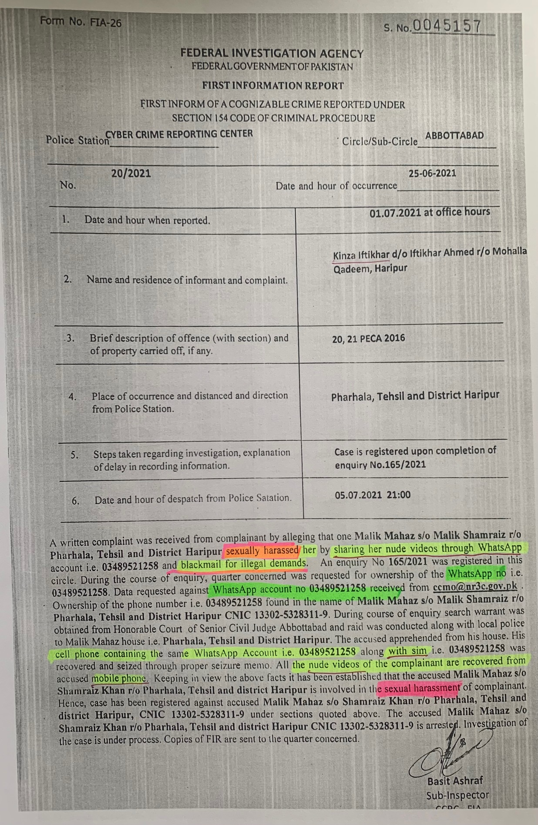

Slide 28
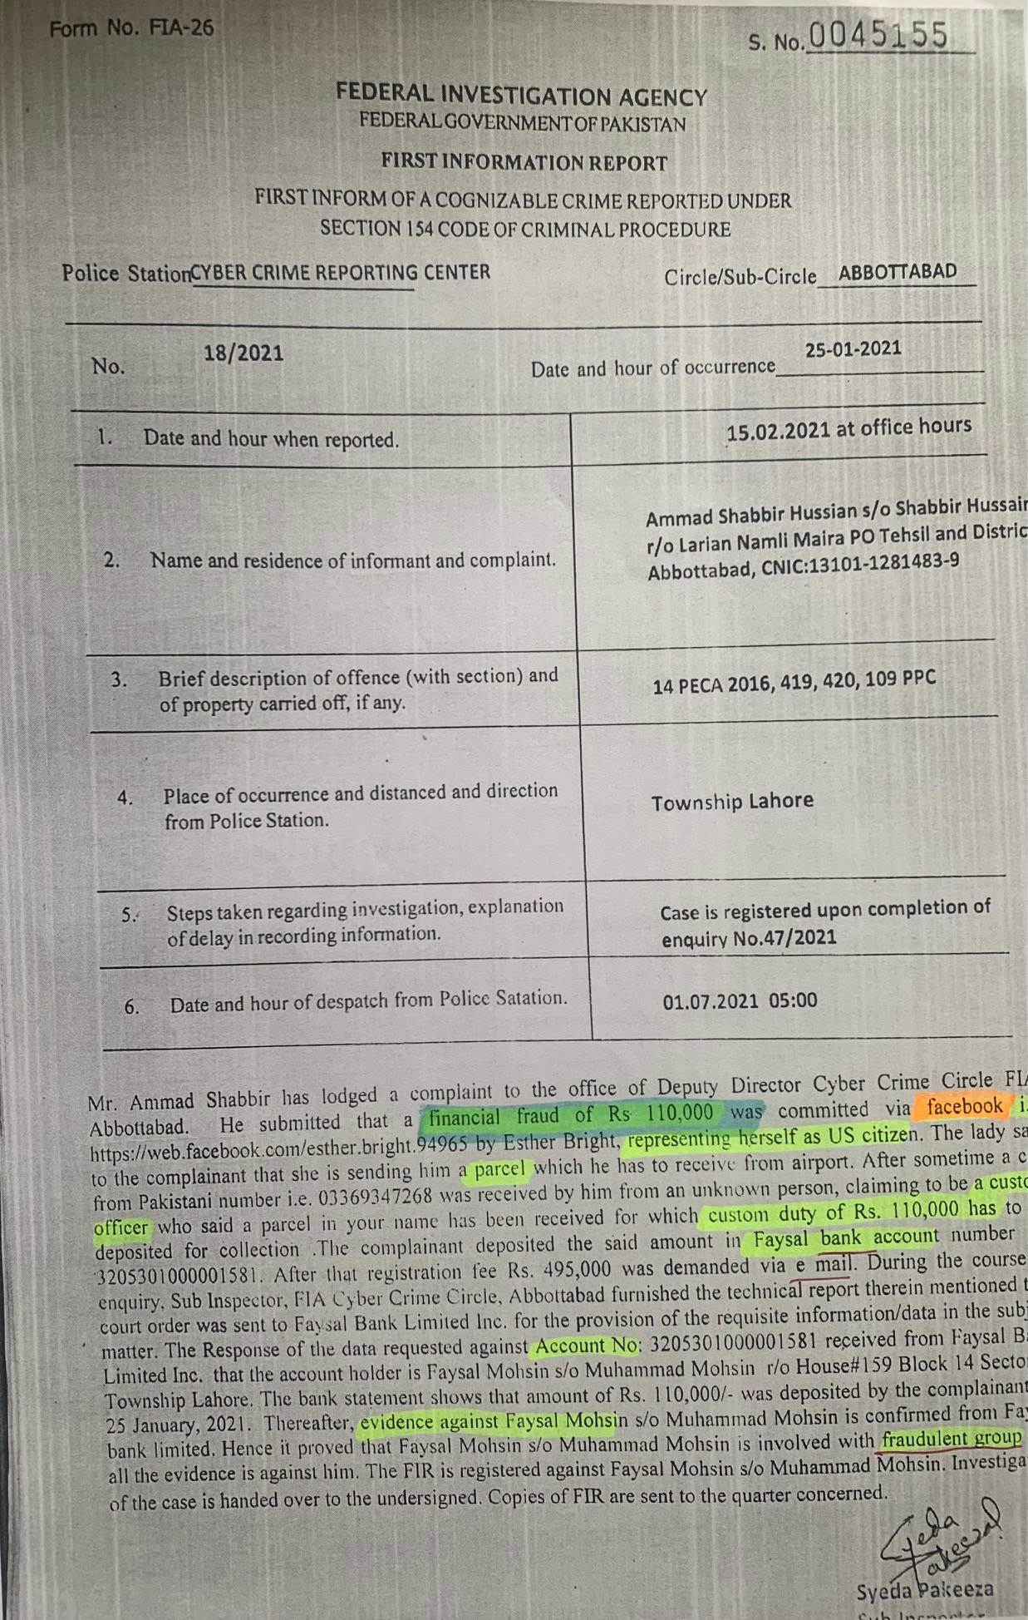

Slide 29
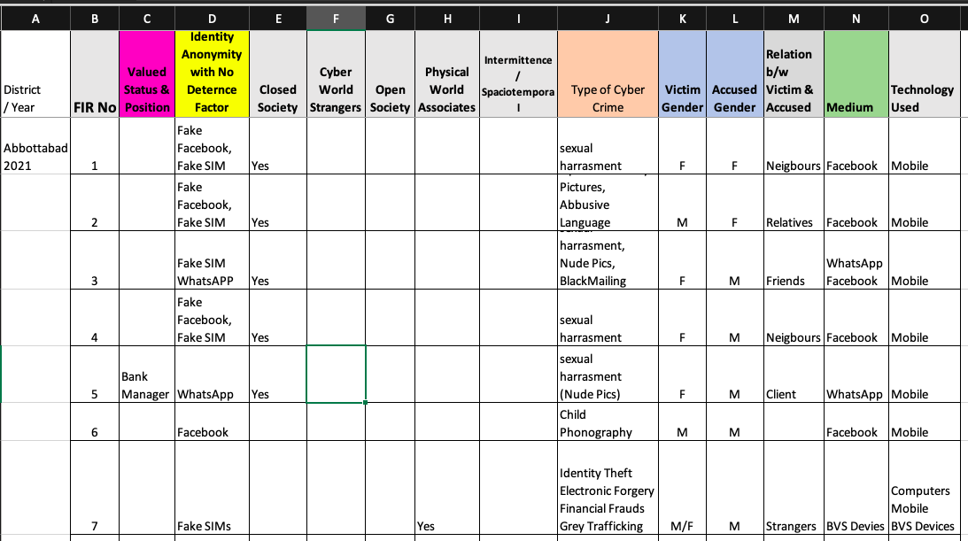
Excerts

Slide 30
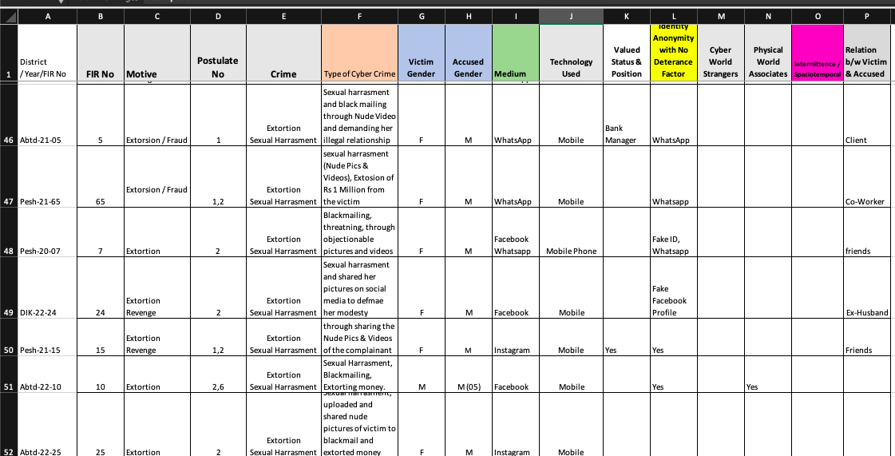

Slide 31
Findings / Results

Slide 32
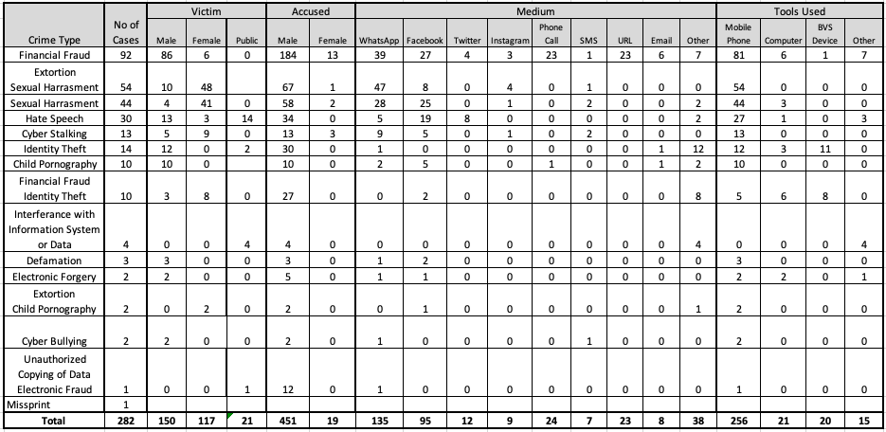
Cybercrime 2020,2021,2022

Slide 33
Medium / Platform used in Cybercrimes
Tools / Devices used in Cybercrimes
Platform | No. of Cases | %
WhatsApp | 135 | 38.5%
Facebook | 95 | 27.1%
Phone Call | 24 | 6.8%
URL / Website | 23 | 6.6%
Instagram | 9 | 2.6%
Email | 8 | 2.3%
SMS | 7 | 2%
Other | 38 | 10.8%
Tools / Devices | No. of Cases | %
Mobile Phone | 256 | 82.1%
Computer | 21 | 6.7%
BVS | 20 | 6.4%
Other | 15 | 4.8%

Slide 34
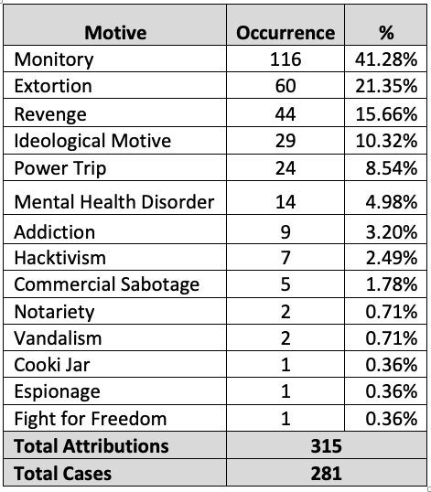
Motivations behind the cases

Slide 35
Cases Registered: Year (2020, 2021,2022)
Total Registered Cases 282 cases
Victim Breakdown = 288
150 male victims
117 female victims
21 cases involving the general public
Total Accused = 470
451 males
19 females

Slide 36
Discussion

Slide 37
A-Platform Utilization and Space Transition
WhatsApp (135 cases) and Facebook (95 cases) are key platforms for cybercrimes.
Mobile Phones - Primary tool in 256 cases, enabling the transition from physical to cyberspace.
The high reliance on mobile phones as tools for these crimes, implicated in 256 cases, further highlights the role of ubiquitous technology in facilitating the transition to cyberspace.
Mobile devices act as gateways, enabling individuals to move between the physical and digital space smoothly, thus expanding the scope and reach of criminal activities.

Slide 38
B- Gender Disparity and the Anonymity of Cyberspace
Significant gender disparity: women more targeted in harassment cases.
Space Transition Theory explains how anonymity in cyberspace amplifies gender-based violence.
Cyberspace shields offenders, mostly male, from real-world consequences, encouraging impunity.
Lack of immediate repercussions increases risk for women.

Slide 39
C- Motivations Driving Cyber Offenses: Economic and Ideological Factors
Economic gain: Main motive in 41.28% of cases (fraud/extortion).
Ideological motives in 10.32% of cases (extremism-related crimes).
Cyberspace expands offender reach, enabling wider victim targeting.
Ideologically motivated crimes facilitated by online connectivity.

Slide 40
D- Cyberspace-Physical Space Fluidity in Cybercrime
Offenders use physical tools (e.g., BVS devices, fake fingerprints) for cybercrimes.
Digital crimes have real-world impacts (financial harm, harassment).
Cyberspace and physical space blend, affecting victims offline.
Need for integrated digital-physical crime prevention strategies.

Slide 41
Thank You

Slide 42
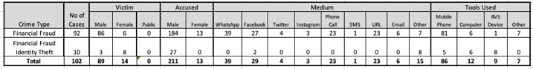
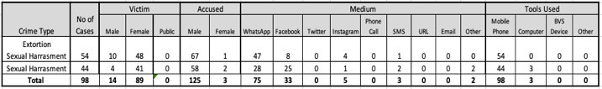
Financial Fraud
Harassment

Slide 43
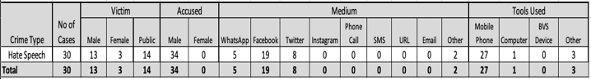
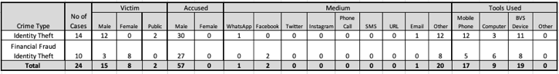
Hate Speech
Identity Theft

Slide 44
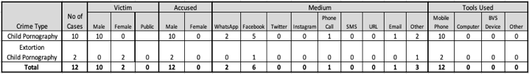
Cyber Stalking
Child Pornography

Slide 45
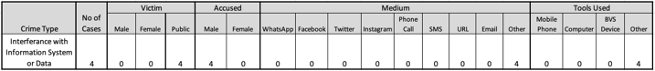
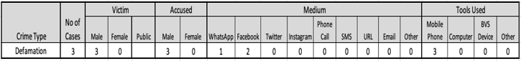
Interference with information systems or data
Defamation

Slide 46
Electronic forgery
Cyberbullying

Slide 47
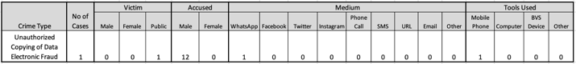
Unauthorized copying of data

Slide 48
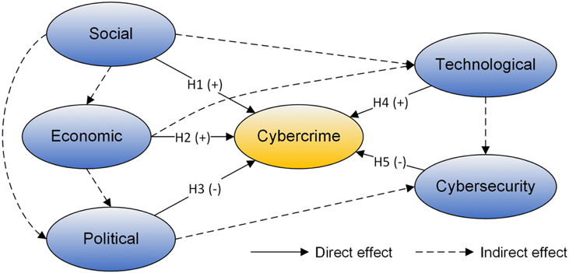
Fig. 1 The conceptual framework for analysing driving forces of cybercrime
Chen, S., Hao, M., Ding, F., Jiang, D., Dong, J., Zhang, S., ... & Gao, C. (2023). Exploring the global geography of cybercrime and its driving forces. Humanities and Social Sciences Communications, 10(1), 1-10.

Slide 49
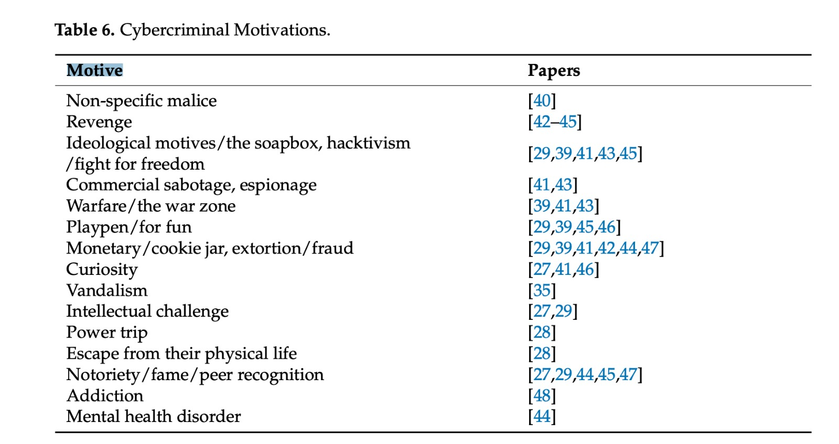
Martineau, M., Spiridon, E., & Aiken, M. (2023). A Comprehensive Framework for Cyber Behavioral Analysis Based on a Systematic Review of Cyber Profiling Literature. Forensic Sciences, 3(3), 452-477.

Slide 50
Definitions
Term | Reference | Definition
Identity Flexibility | Wallace, P. (2015). The psychology of the Internet. Cambridge University Press. | The skill of a person to change how they appear or present themselves (online), and then go back to their usual identity when necessary
Dissociative anonymity | Wallace, P. (2015). The psychology of the Internet. Cambridge University Press. | The dissociative anonymity depicts states in which an individual’s identity is unknown and also detached from the individual or environment (Wallace, 1999).
Intermittent ventures | Wall, D. S. (2008). Cybercrime and the culture of fear: Social science fiction (s) and the production of knowledge about cybercrime. Information, Communication & Society, 11(6), 861-884. | "Intermittent ventures of offenders into cyberspace" refers to the periodic or occasional engagement of individuals in online criminal activities. This concept suggests that offenders may not continuously operate in cyberspace but rather dip in and out of it for specific purposes or at certain times.
Dynamic spatio-temporal nature of cyberspace |  | The "dynamic spatio-temporal nature of cyberspace" refers to the constantly changing and evolving characteristics of the online environment in terms of both space (location or context) and time. This concept recognizes that cyberspace is not static but rather fluid and adaptable, with digital interactions occurring across various locations and timescales.
Closed society | Popper, K. R. (2020). The open society and its enemies (Vol. 119). Princeton University Press. | A closed society in this context refers to a social and political system characterized by authoritarianism, censorship, and limited individual freedoms. In a closed society, government control over information and communication is high, dissent is suppressed, and citizens may face restrictions on their online activities. In such environments, individuals may be more prone to engage in cybercrimes due to limited opportunities for legitimate expression, lack of trust in legal institutions, and a sense of impunity for illegal activities online.

Slide 51
Term | Reference | Definition
Open society | Popper, K. R. (2020). The open society and its enemies (Vol. 119). Princeton University Press. | An open society in this context refers to a social and political environment where there is a high degree of transparency, individual freedom, and democratic governance. In an open society, citizens have access to information, can freely express their opinions, and participate in decision-making processes. There is typically a strong emphasis on civil liberties, human rights, and the rule of law. In relation to cybercrime, individuals in an open society may have greater awareness of ethical behavior online, access to resources for digital literacy, and trust in legal institutions, which may discourage engagement in criminal activities in cyberspace.
Cyber Space | Stückelberger, C., & Duggal, P. (2018). Cyber ethics 4.0. Geneva: Globethics. net. | Cyber Space is the whole global space of virtual reality, a parallel world to the physical world, with uncountable interactions with the physical world. (Rephrasing Needed)
Values |  | Values are general benchmarks of orientation for individuals, communities and institutions for what is good and right, such as freedom, justice and peace. (Rephrasing Needed)
Virtues |  | Virtues are benchmarks for individual behaviour for what is good and right such as honesty and modesty. They are often common to all human beings, but different in their priorities, contextualisation and jus- tification (Rephrasing Needed)
Norms |  | Norms (ethical) are rules, based on values and virtues, but concretised for specific situations. E.g. the value or fairness and the virtue of honesty lead to the norm “you should not steal”. (Rephrasing Needed)

Slide 52
Term | Reference | Definition
Mental health disorder / Mental health illness. | Back, S., LaPrade, J., Shehadeh, L., & Kim, M. (2019, June). Youth hackers and adult hackers in South Korea: an application of cybercriminal profiling. In 2019 IEEE European Symposium on Security and Privacy Workshops (EuroS&PW)(pp. 410-413). IEEE. | "mental health disorder" refers to a condition that affects an individual's cognitive processes, emotions, and behaviors, leading to difficulties in thinking, feeling, and acting in a way that is considered typical or socially acceptable. Specifically, in the case of hackers, personality disorders may manifest as abnormalities in their thought patterns, emotions, and actions, which contribute to their engagement in criminal activities related to hacking. These disorders may involve disruptions in perception, judgment, impulse control, or interpersonal relationships, ultimately influencing the individual's decision-making and behavior towards committing crimes.
Cooki jar | Becker, J. (1982). Who are the computer criminals?. ACM SIGCAS Computers and Society, 12(1), 18-20. | It refers to the perception of the computer environment as a potential source of easy money for a particular type of computer criminal. This type of criminal views the computer system or network as a reservoir of valuable resources that can be exploited to fulfill immediate financial needs or desires. The reservoir from which ample funds are drawn to address sudden financial requirements.
Powertrip | Holt, T. J. (2007). Subcultural evolution? Examining the influence of on-and off-line experiences on deviant subcultures. Deviant behavior, 28(2), 171-198. | power trip" refers to the psychological state in which individuals are motivated to engage in deviant behavior related to computers due to the sense of empowerment, status, or ego boost it provides. This term suggests that the desire for power, recognition, or personal gratification drives individuals to continue their actions, as they derive satisfaction from the feeling of being in control or superior within the digital realm.

Slide 53
Term | Reference | Definition
Addiction | Woo, H. J. (2003). The hacker mentality: Exploring the relationship between psychological variables and hacking activities (Doctoral dissertation, University of Georgia). | Addiction to hacking is when someone feels compelled to keep hacking because they enjoy the challenge and satisfaction it brings. They keep doing it because they want to experience that feeling again and again.
Extorsion/fraud | Back, S., LaPrade, J., Shehadeh, L., & Kim, M. (2019, June). Youth hackers and adult hackers in South Korea: an application of cybercriminal profiling. In 2019 IEEE European Symposium on Security and Privacy Workshops (EuroS&PW)(pp. 410-413). IEEE | "extortion" refers to the act of obtaining something, typically money, property, or services, from an individual or organization through coercion or threats of harm. Extortion in the realm of computer hacking involves using the threat of cyberattacks or the exposure of sensitive information to manipulate victims into complying with the hacker's demands. This could include demands for monetary payment, access to confidential data, or other concessions, with the intention of causing mental distress or harm to the victim. Extortion through hacking may also involve threats of further cyberattacks or damage if the victim does not meet the hacker's demands.
Warfare / Warzone | Becker, J. (1982). Who are the computer criminals?. ACM SIGCAS Computers and Society, 12(1), 18-20. | "war zone" illustrates how some disgruntled employees perceive the computer environment as a symbolic battleground where they can express their grievances and frustrations against their employer, feeling motivated to take action as a form of protest or resistance.

Slide 54
Term | Reference | Definition
Commercial sabotage | Back, S., LaPrade, J., Shehadeh, L., & Kim, M. (2019, June). Youth hackers and adult hackers in South Korea: an application of cybercriminal profiling. In 2019 IEEE European Symposium on Security and Privacy Workshops (EuroS&PW)(pp. 410-413). IEEE. | "commercial sabotage" refers to the deliberate act of damaging or disrupting the hardware or software of a business or commercial entity for personal gain, financial advantage, or to benefit one's own country or interests. This could involve actions such as intentionally compromising computer systems, networks, or infrastructure belonging to a competitor or rival company in order to gain a competitive edge, weaken their market position, or undermine their operations. Commercial sabotage may also be carried out as part of economic espionage or cyberwarfare campaigns aimed at achieving strategic or financial objectives.
Revenge | Back, S., LaPrade, J., Shehadeh, L., & Kim, M. (2019, June). Youth hackers and adult hackers in South Korea: an application of cybercriminal profiling. In 2019 IEEE European Symposium on Security and Privacy Workshops (EuroS&PW)(pp. 410-413). IEEE. | "revenge" refers to the motive for computer hacking where individuals seek to retaliate against perceived wrongs done to them. This retaliation involves causing harm or damage to individuals, businesses, or society as a form of payback for the perceived injustice or harm inflicted upon the hacker.
Curiosity | Holt, T. J. (2007). Subcultural evolution? Examining the influence of on-and off-line experiences on deviant subcultures. Deviant behavior, 28(2), 171-198. | curiosity" refers to the innate desire and interest in exploring the unknown, seeking knowledge, and discovering new information. It involves a sense of wonder and an eagerness to learn, understand, and investigate various subjects or areas, including the workings of computer systems. For hackers, curiosity serves as a driving force, motivating them to delve into different aspects of technology, whether it be understanding the intricacies of software or gaining insights into human behavior. This curiosity-driven approach fosters a mindset of exploration and discovery, leading hackers to pursue their goals and expand their understanding of the world around them.

Slide 55
Term | Reference | Definition
Notoriety/ Fame/ Peer recognition | Back, S., LaPrade, J., Shehadeh, L., & Kim, M. (2019, June). Youth hackers and adult hackers in South Korea: an application of cybercriminal profiling. In 2019 IEEE European Symposium on Security and Privacy Workshops (EuroS&PW)(pp. 410-413). IEEE. | Fame: In the context of the text, "fame" refers to the desire for public recognition or renown, where hackers seek acknowledgment and attention for their hacking activities. They may aim to gain widespread recognition within the hacking community or even achieve notoriety in the broader public sphere for their skills or exploits. Peer Recognition: "Peer recognition" pertains to the acknowledgment and validation received from fellow members of the hacking community or peers who share similar interests and expertise. It involves earning respect and admiration from others within the hacking subculture, often through demonstrating proficiency, leadership, or innovative techniques in hacking activities.
Espionage | Back, S., LaPrade, J., Shehadeh, L., & Kim, M. (2019, June). Youth hackers and adult hackers in South Korea: an application of cybercriminal profiling. In 2019 IEEE European Symposium on Security and Privacy Workshops (EuroS&PW)(pp. 410-413). IEEE | "espionage" means spying or using spies to steal important political and military information. It's usually done by one government against another to gain an advantage.
Ideological motives | Back, S., LaPrade, J., Shehadeh, L., & Kim, M. (2019, June). Youth hackers and adult hackers in South Korea: an application of cybercriminal profiling. In 2019 IEEE European Symposium on Security and Privacy Workshops (EuroS&PW)(pp. 410-413). IEEE. | "ideological motives" refer to the underlying beliefs, principles, or doctrines that drive individuals or groups to engage in hactivism. These motives stem from differing political, philosophical, or religious ideologies held by both attackers and victims. Ideological motives fuel the desire to express, promote, or defend specific sets of ideas, values, or agendas through hacking activities, often resulting in conflicts or clashes between opposing viewpoints.

Slide 56
Term | Reference | Definition
Hacktivism / Fight for freedom | Back, S., LaPrade, J., Shehadeh, L., & Kim, M. (2019, June). Youth hackers and adult hackers in South Korea: an application of cybercriminal profiling. In 2019 IEEE European Symposium on Security and Privacy Workshops (EuroS&PW)(pp. 410-413). IEEE. | "hactivism" refers to the use of hacking techniques or cyberattacks as a means of advancing or expressing political, ideological, or religious beliefs. Hactivism involves targeting individuals, organizations, or systems perceived as representing opposing or conflicting ideas, with the aim of promoting a particular cause, agenda, or worldview through digital means.
Intellectual challenge | Madarie, R. (2017). Hackers' Motivations: Testing Schwartz's Theory of Motivational Types of Values in a Sample of Hackers. International Journal of Cyber Criminology, 11(1). | It refers to the desire or motivation for individuals to test their intellectual abilities and problem-solving skills by attempting to circumvent security systems.
Vandalism | Ferenc, I. (2012). The cyberspace and its risks. Hadmrnk, 7(2), 276291. | “Cyber vandalism" refers to the malicious and disruptive activities carried out by individuals, often termed as script kiddies, who deface websites for entertainment or thrill-seeking purposes. Similar to traditional vandalism, where physical property is damaged or defaced, cyber vandalism involves the unauthorized alteration or destruction of digital content, such as websites, with the intent to cause disruption or express rebellion.

Slide 57
Term | Reference | Definition
Monitory | Gordon, S., & Ma, Q. (2003). Convergence of virus writers and hackers: Fact or fantasy. Cupertine, CA: Symantec Security White paper. Holt, T. J., & Kilger, M. (2008, April). Techcrafters and makecrafters: A comparison of two populations of hackers. In 2008 WOMBAT workshop on information security threats data collection and sharing (pp. 67-78). IEEE. | It refers to the financial gain or the promise of money serves as motivation for individuals to continue engaging in deviant behavior related to computers, such as hacking or cybercrime.
Playpen / for fun | Becker, J. (1982). Who are the computer criminals?. ACM SIGCAS Computers and Society, 12(1), 18-20. | Playpen/for fun refers to the motive for engaging in illegal online activities simply for the sake of entertainment or enjoyment. This motivation suggests that individuals may perpetrate cybercrimes, such as hacking or online fraud, as a form of amusement or thrill-seeking behavior, rather than for any specific financial gain or ideological purpose.
Soapbox | Becker, J. (1982). Who are the computer criminals?. ACM SIGCAS Computers and Society, 12(1), 18-20. | "soapbox" refers to a mindset where people see computers as something they dislike or find oppressive. Instead of targeting specific people or companies, they commit cybercrimes as a way to rebel against computers in general. Their motive for cybercrime is to challenge the power of computers, rather than to seek revenge or money from a particular target.

Slide 58
Term | Reference | Definition
Motive | Veresha, R. V. (2016). Determination Motive through the Prism of the General Concept of the Motives of Human Behaviour. International Journal of Environmental and Science Education, 11(11), 4739-4750. 2 . Cook, W. W. (1917). Act, intention, and motive in the criminal law. The Yale Law Journal, 26(8), 645-663. | The motive for a crime is a deliberate drive to achieve a goal, driven by personal needs, that is socially dangerous and leads to criminal liability (Veresha, 2016). 2. Motive refers to the ulterior intent behind a wrongful act, distinct from the immediate intent. While the immediate intent pertains to the wrongful act itself, such as a thief stealing money, the motive is the ultimate goal or desired outcome that drives the wrongdoer to commit the act. This ulterior intent is the reason behind the wrongful act, such as using the stolen money to buy food or pay off a debt. Thus, motive is the underlying reason or purpose for which the wrongful act is carried out
Financial Fraud | Nicholls, J., Kuppa, A., & Le-Khac, N. A. (2021). Financial cybercrime: A comprehensive survey of deep learning approaches to tackle the evolving financial crime landscape. Ieee Access, 9, 163965-163986. | illegal acts committed by an individual or a group of individuals to obtain a financial or professional advantage. The primary motive in such crimes is economic gain (Nicholls, Kuppa, & Le-Khac, 2021).
Online harassment | Lazarus, S., Button, M., & Kapend, R. (2022). Exploring the value of feminist theory in understanding digital crimes: Gender and cybercrime types. The Howard Journal of Crime and Justice, 61(3), 381-398. | Online harassment is defined as the act of aggressively pressuring, intimidating, distressing, or spreading defamatory rumors about others (Lazarus, Button, & Kapend, 2022).

Slide 59
Term | Reference | Definition
Hate speech | Sabillon, R., Cano, J. J., Cavaller Reyes, V., & Serra Ruiz, J. (2016). Cybercrime and cybercriminals: A comprehensive study. International Journal of Computer Networks and Communications Security, 2016, 4 (6). | Online hate speech includes various expressions that undermine social rights, liberties, and freedom of expression. It targets races, religions, nationalities, ethnicities, countries, individuals, groups, minorities, migrants, gender identities, disabilities, national origins, political parties, sports teams, sexual orientations, youth, the elderly, children, and animals (Sabillon et al., 2016).
Cyberstalking | Lazarus, S., Button, M., & Kapend, R. (2022). Exploring the value of feminist theory in understanding digital crimes: Gender and cybercrime types. The Howard Journal of Crime and Justice, 61(3), 381-398. | Cyberstalking or cyber dating abuse involves using the Internet and various technological devices to monitor, harass, or threaten another individual (Lazarus, Button, & Kapend, 2022).
Cyber Bullying | Lazarus, S., Button, M., & Kapend, R. (2022). Exploring the value of feminist theory in understanding digital crimes: Gender and cybercrime types. The Howard Journal of Crime and Justice, 61(3), 381-398. | Bullying involves deliberate and repeated aggressive behavior toward a victim. However, in cyberbullying, the typical power imbalance and repeated pattern of traditional bullying may not always be present (Lazarus, Button, & Kapend, 2022).
 | Patchin, J. W., & Hinduja, S. (2006). Bullies move beyond the schoolyard: A preliminary look at cyberbullying. Youth violence and juvenile justice, 4(2), 148-169. | Cyberbullying is the intentional and repeated infliction of harm using computers, cell phones, or other electronic devices (Patchin & Hinduja, 2006).

Slide 60
Term | Reference | Definition
Identity Theft | Sabillon, R., Cano, J. J., Cavaller Reyes, V., & Serra Ruiz, J. (2016). Cybercrime and cybercriminals: A comprehensive study. International Journal of Computer Networks and Communications Security, 2016, 4 (6). | Identity theft happens when someone illegally acquires another person's personal information without their consent, intending to use it for theft or fraudulent activities. This crime often involves deceiving the victim into believing they are providing confidential information to a legitimate organization, typically through email requests for updates to billing or membership details, or through misleading online job ads. Identity theft can facilitate various forms of identity fraud, including financial, business, and criminal identity theft, as well as money laundering (Sabillon et al., 2016).
child pornography | Kunz, M., & Wilson, P. (2004). Computer crime and computer fraud. Report Submitted to the Montgomery County Criminal Justice Coordinating Commission. | Online child pornography refers to the utilization of computer resources by paedophiles for the distribution of illegal media involving minors and engaging in exploitative actions that target children for sexual purposes. This despicable activity involves the dissemination and consumption of illicit materials that exploit vulnerable children, posing a serious threat to their safety and well-being. Efforts are made to identify and apprehend individuals involved in such criminal acts to protect children from harm and ensure justice is served (Kunz & Wilson, 2004).
 | Steel, C. M. (2009). Child pornography in peer-to-peer networks. Child Abuse & Neglect, 33(8), 560-568. | Child pornography is characterized by the visual representation of minors, aged 17 or younger, in sexually explicit or suggestive scenarios, involving real children in exploitative and harmful situations (Steel, 2009).

Slide 61
Term | Reference | Definition
Interference with information systems or data | Freitas, P. M. F., & Gonçalves, N. (2015). Illegal access to information systems and the Directive 2013/40/EU. International Review of Law, Computers & Technology, 29(1), 50-62. | Illegal access is a crime where an individual, often skilled in computer techniques, unlawfully enters an information system without the manager's authorization to access or control its functions or data (Freitas & Gonçalves, 2015). Interference with information systems or data refers to unauthorized actions that disrupt, alter, or compromise the integrity of computer systems, networks, or data. This can include activities such as hacking, data tampering, or deploying malware to obstruct the normal functioning of information technology resources
Defamation | Khan, N., Shaikh, A., & Singh, M. V. P. (2023). Understanding of cyber defamation and its impact: a critical analysis. Dogo Rangsang Res J, 13, 168-173. | Cyber defamation, also known as online defamation, involves making false or derogatory statements about someone via the internet or other digital communication channels like social media, emails, or instant messaging. Defamation refers to the spread of false information that damages the reputation of an individual or organization (Khan, et al., 2023).

